Slide 1
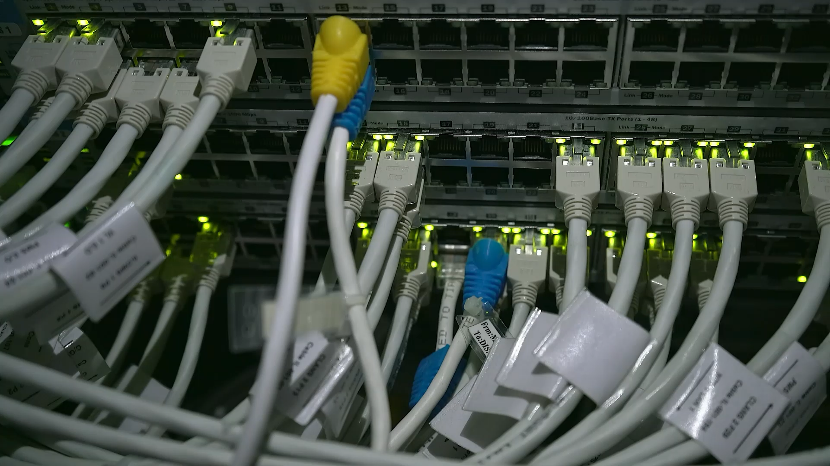
ELEC 391: Digital Communication System Demo 1
Team 2: Bryant, Akshat, Yan

Slide 2
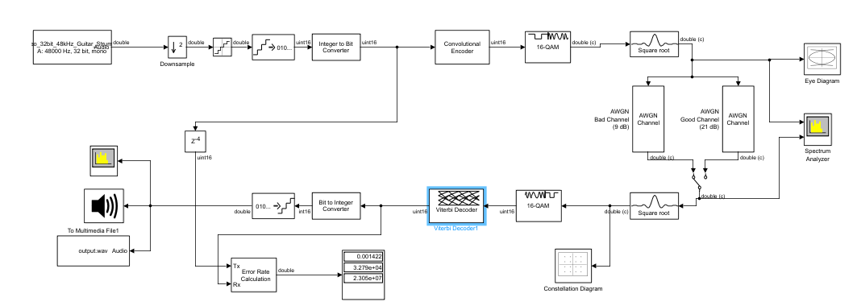
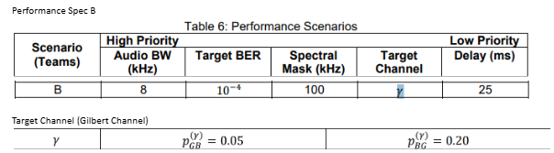

Slide 3
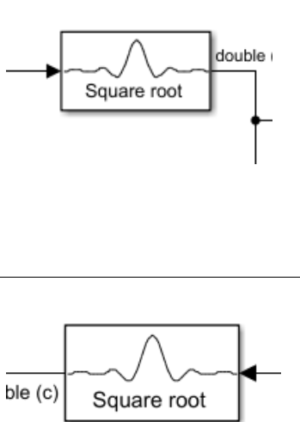
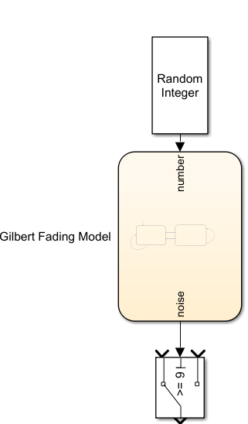
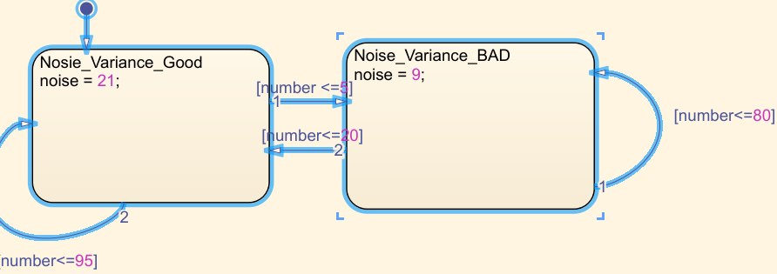
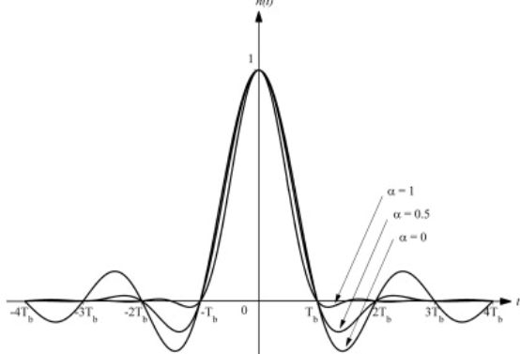
Design Decision 1: Filter/Received, Channels

Slide 4
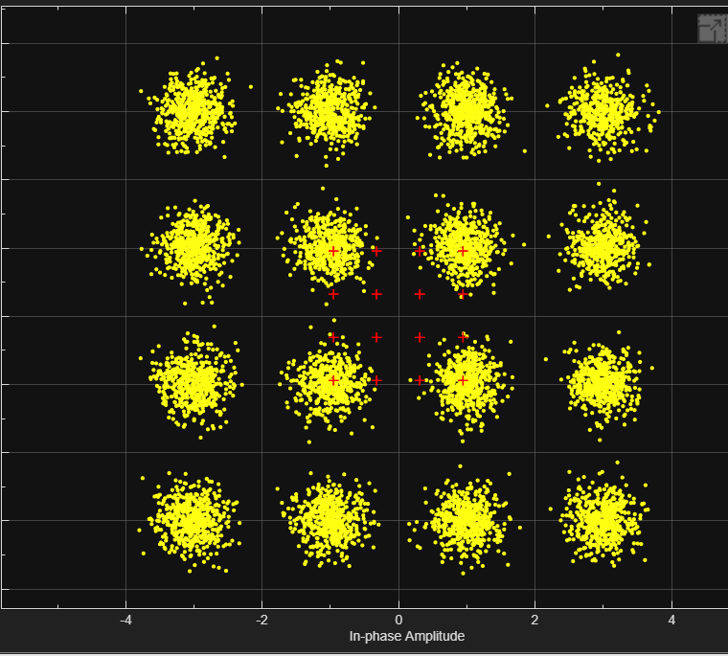
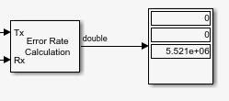
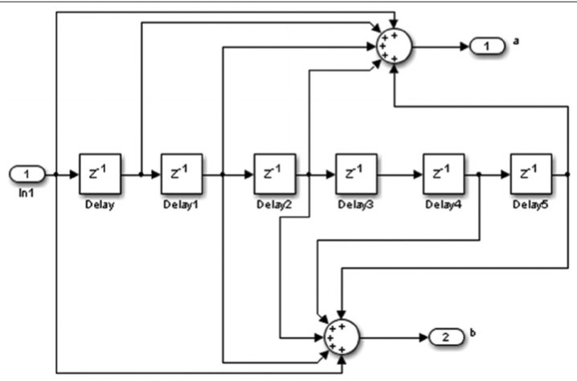
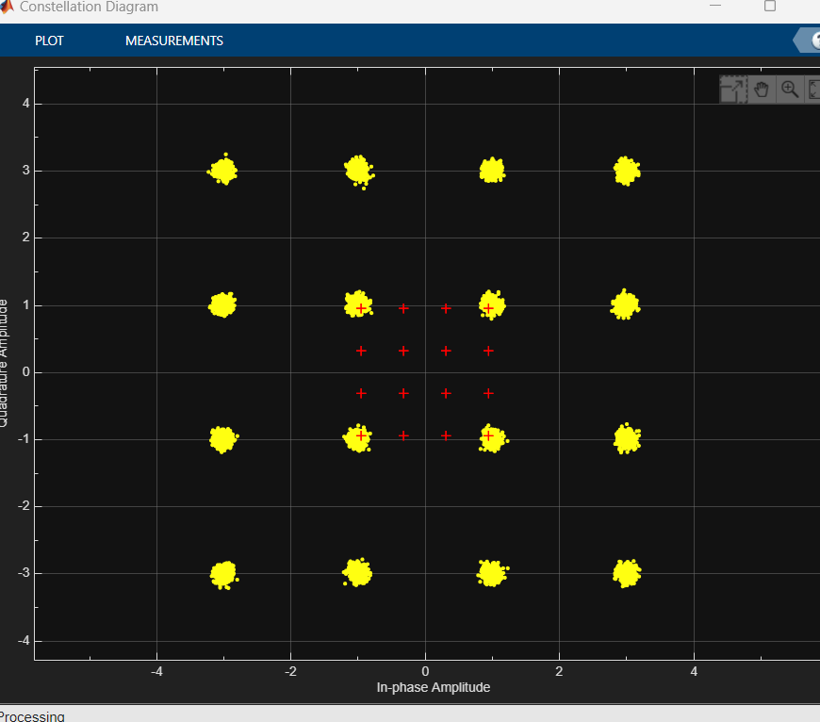
Design Decision 2: Encoding/Decoding and Modulation
Convolutional/Viterbi Code
16-QAM Modulation
BER and Verification
9 dB SNR
(Bad channel)
21 dB SNR
(Good channel)
Correct random errors from AWGN
Efficient use of bandwidth (sending more information in one unit of time)
Higher FPGA implementation complexity, but less than high-rate block encoder
poly2trellis(7,[171 133])

